Slide 1
Compliant mechanism: preliminary results
Gabriele Capasso

Slide 2
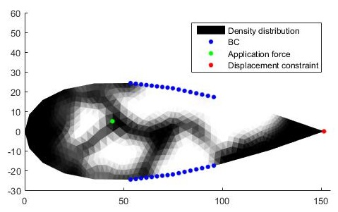





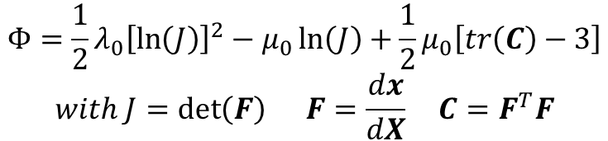
MORPHING WING
$$minimize V(ρ)$$
Light (volume fraction)
$$subject to$$
$$U_{e}(ρ)≥U_{0}$$
Morphing
$$σ_{i}(ρ,U_{f}(ρ))≤σ_{lim}$$
Feasible
$$E=ρ^{p}E_{0}$$
Nonlinear potential density:
$$Φ=\frac{1}{2}λ_{0}{\left[\ln\left(J\right)\right]}^{2}−μ_{0}\ln\left(J\right)+\frac{1}{2}μ_{0}\left[tr\left(C\right)−3\right]$$
$$with J=\det\left(F\right) F=\frac{dx}{dX} C=F^{T}F$$

Slide 3
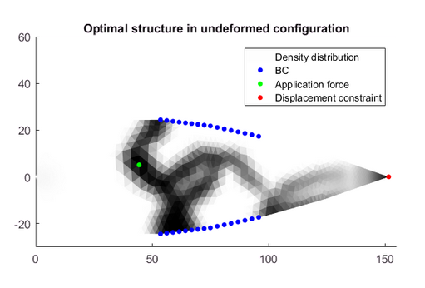
MORPHING WING
$$minimize V(ρ)$$
Light (volume fraction)
$$subject to$$
$$U_{e}(ρ)≥U_{0}$$
Morphing
$$σ_{i}(ρ,U_{f}(ρ))≤σ_{lim}$$
Feasible
$$E={E_{min}+ρ}^{p}\left(E_{0}−E_{min}\right) E_{min}=E_{0}∗{10}^{−3}$$
Nonlinear potential density:
$$Φ=\frac{1}{2}λ_{0}{\left[\ln\left(J\right)\right]}^{2}−μ_{0}\ln\left(J\right)+\frac{1}{2}μ_{0}\left[tr\left(C\right)−3\right]$$
$$with J=\det\left(F\right) F=\frac{dx}{dX} C=F^{T}F$$

Slide 4
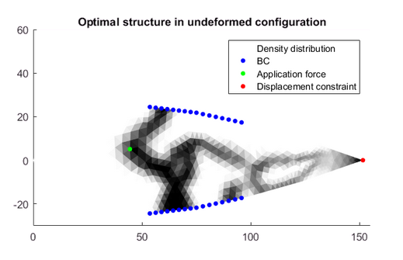
MORPHING WING
$$minimize V(ρ)$$
Light (volume fraction)
$$subject to$$
$$U_{e}(ρ)≥U_{0}$$
Morphing
$$σ_{i}(ρ,U_{f}(ρ))≤σ_{lim}$$
Feasible
$$E={E_{min}+ρ}^{p}\left(E_{0}−E_{min}\right) E_{min}=E_{0}∗{10}^{−3}$$
Nonlinear potential density:
$$Φ=\frac{1}{2}λ_{0}{\left[\ln\left(J\right)\right]}^{2}−μ_{0}\ln\left(J\right)+\frac{1}{2}μ_{0}\left[tr\left(C\right)−3\right]$$
$$with J=\det\left(F\right) F=\frac{dx}{dX} C=F^{T}F$$
Adapted density-filtering

Slide 5
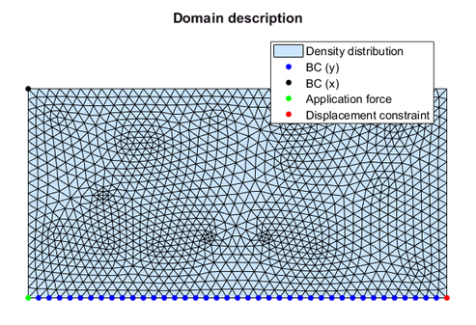
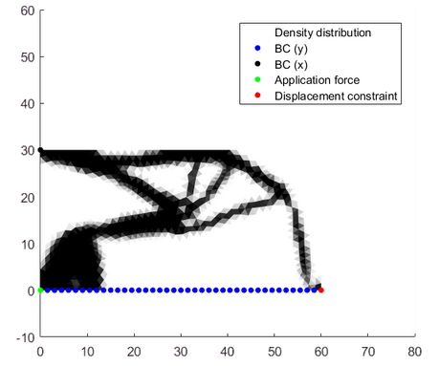



GEOMETRIC INVERTER
$$minimize U_{out}/U_{in}(ρ)$$
Light (volume fraction)
$$subject to$$
$$V(ρ)≤V_{0}$$
Morphing
$$σ_{i}(ρ,U_{f}(ρ))≤σ_{lim}$$
Feasible
$$C_{out}\left(ρ,U_{f}\left(ρ\right)\right)≥C_{min}$$
Continuous chain
$$E={E_{min}+ρ}^{p}\left(E_{0}−E_{min}\right) E_{min}=E_{0}∗{10}^{−3}$$
Nonlinear potential density:
$$Φ=\frac{1}{2}λ_{0}{\left[\ln\left(J\right)\right]}^{2}−μ_{0}\ln\left(J\right)+\frac{1}{2}μ_{0}\left[tr\left(C\right)−3\right]$$
$$with J=\det\left(F\right) F=\frac{dx}{dX} C=F^{T}F$$
Double compliance

Slide 6
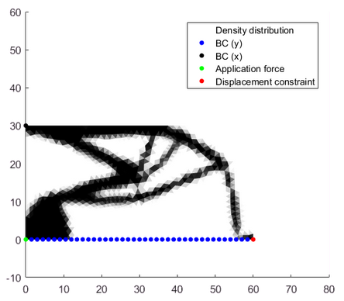
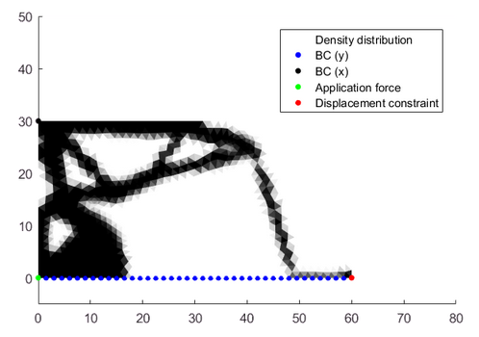


GEOMETRIC INVERTER
$$minimize U_{out}/U_{in}(ρ)$$
Light (volume fraction)
$$subject to$$
$$V(ρ)≤V_{0}$$
Morphing
$$σ_{lim}=0.4 MPa$$
$$σ_{i}(ρ,U_{f}(ρ))≤σ_{lim}$$
Feasible
$$C_{out}\left(ρ,U_{f}\left(ρ\right)\right)≥C_{min}$$
Continuous chain
$$E={E_{min}+ρ}^{p}\left(E_{0}−E_{min}\right) E_{min}=E_{0}∗{10}^{−3}$$
Nonlinear potential density:
$$Φ=\frac{1}{2}λ_{0}{\left[\ln\left(J\right)\right]}^{2}−μ_{0}\ln\left(J\right)+\frac{1}{2}μ_{0}\left[tr\left(C\right)−3\right]$$
$$with J=\det\left(F\right) F=\frac{dx}{dX} C=F^{T}F$$
$$σ_{lim}=0.3 MPa$$
Single compliance

Slide 7
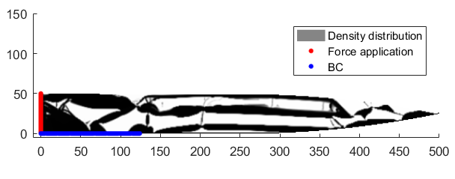
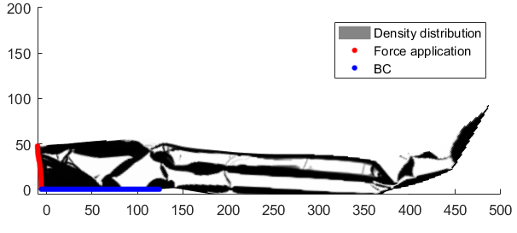






MORPHING WINGLET
$$minimize {\left|\left|LU−U_{obj}\right|\right|}^{2}(ρ,f)$$
Morphing winglet
$$subject to$$
$$V\left(ρ\right)≤V_{0}=0,45$$
Light (volume fraction)
$$σ_{i}\left(ρ,f,U_{f}\left(ρ,f\right)\right)≤σ_{lim}=0,5$$
Feasible
$$C\left(ρ,f,U_{f}\left(ρ,f\right)\right)≤C_{max}=20$$
Continuous chain
$$∑F\left(ρ,f \right)≤F_{min}=−1$$
Continuous chain
$$F=\frac{\arctan\left(sf\right)}{\arctan\left(s\right)}ρ_{node}^{k} k=1$$
$$E={E_{min}+ρ}^{p}\left(E_{0}−E_{min}\right) E_{min}=E_{0}∗{10}^{−4}$$
Linear FE Analysis

Slide 8
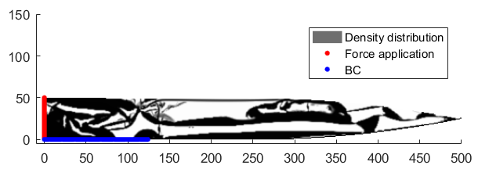
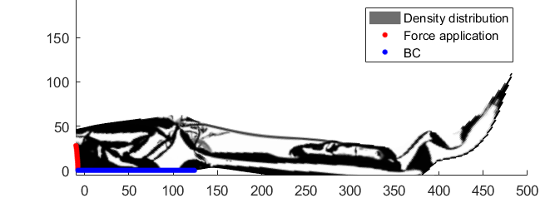




MORPHING WINGLET
$$minimize {\left|\left|LU−U_{obj}\right|\right|}^{2}(ρ,f)$$
Morphing winglet
$$subject to$$
$$V\left(ρ\right)≤V_{0}=0,45$$
Light (volume fraction)
$$σ_{i}\left(ρ,f,U_{f}\left(ρ,f\right)\right)≤σ_{lim}=0,5$$
Feasible
$$C\left(ρ,f,U_{f}\left(ρ,f\right)\right)≤C_{max}=20$$
Continuous chain
$$∑F\left(ρ,f \right)≤F_{min}=−1$$
Continuous chain
$$F=\frac{\arctan\left(sf\right)}{\arctan\left(s\right)}ρ_{node}^{k} k=1/p$$
$$E={E_{min}+ρ}^{p}\left(E_{0}−E_{min}\right) E_{min}=E_{0}∗{10}^{−4}$$
Linear FE Analysis

Slide 9
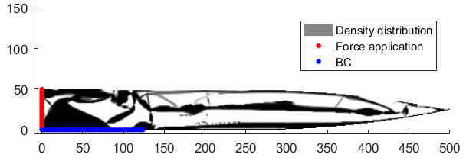
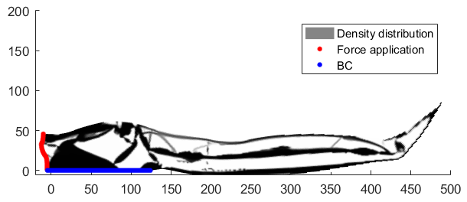



MORPHING WINGLET
$$minimize {\left|\left|LU−U_{obj}\right|\right|}^{2}(ρ,f)$$
Morphing winglet
$$subject to$$
$$V\left(ρ\right)≤V_{0}=0,45$$
Light (volume fraction)
$$σ_{i}\left(ρ,f,U_{f}\left(ρ,f\right)\right)≤σ_{lim}=0,5$$
Feasible
$$C\left(ρ,f,U_{f}\left(ρ,f\right)\right)≤C_{max}=20$$
Continuous chain
$$∑F\left(ρ,f \right)≤F_{min}=−1$$
Continuous chain
$$F=\frac{\arctan\left(sf\right)}{\arctan\left(s\right)}ρ_{node}^{k} k=1/p$$
$$E={E_{min}+ρ}^{p}\left(E_{0}−E_{min}\right) E_{min}=E_{0}∗{10}^{−4}$$
Linear FE Analysis

Slide 10

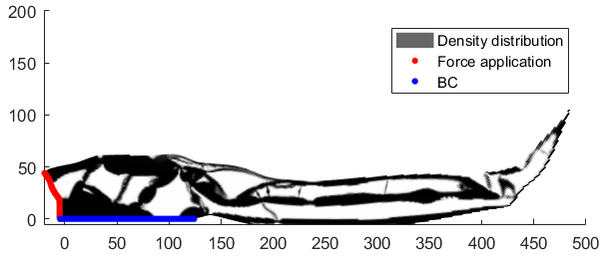




MORPHING WINGLET
$$minimize {\left|\left|LU−U_{obj}\right|\right|}^{2}(ρ,f)$$
Morphing winglet
$$subject to$$
$$V(ρ)≤V_{0}$$
Light (volume fraction)
$$σ_{i}(ρ,f,U_{f}(ρ,f))≤σ_{lim}$$
Feasible
$$C\left(ρ,f,U_{f}\left(ρ,f\right)\right)≤C_{max}$$
Continuous chain
$$∑F\left(ρ,f \right)≤F_{min}=−1,5$$
Continuous chain
$$F=\frac{\arctan\left(sf\right)}{\arctan\left(s\right)}ρ_{node}^{k} k=1/p$$
$$E={E_{min}+ρ}^{p}\left(E_{0}−E_{min}\right) E_{min}=E_{0}∗{10}^{−4}$$
Linear FE Analysis

Slide 11
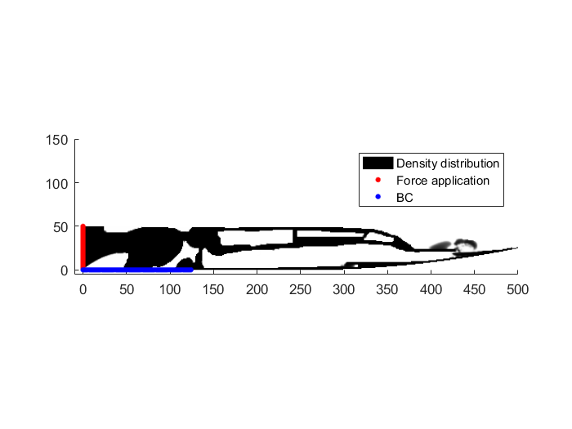
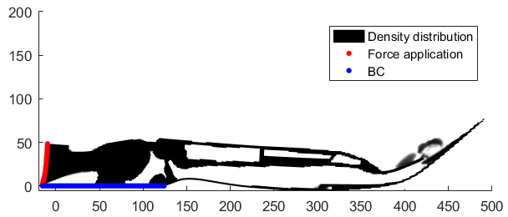

MORPHING WINGLET
$$minimize {\left|\left|LU−U_{obj}\right|\right|}^{2}(ρ,f)$$
Morphing winglet
$$subject to$$
$$V(ρ)≤V_{0}$$
Light (volume fraction)
$$σ_{i}(ρ,f,U_{f}(ρ,f))≤σ_{lim}$$
Feasible
$$C\left(ρ,f,U_{f}\left(ρ,f\right)\right)≤C_{max}$$
Continuous chain
$$∑F\left(ρ,f \right)≤F_{min}=−1,5$$
Continuous chain
$$F=\frac{\arctan\left(sf\right)}{\arctan\left(s\right)}ρ_{node}^{k} k=p$$
$$E={E_{min}+ρ}^{p}\left(E_{0}−E_{min}\right) E_{min}=E_{0}∗{10}^{−4}$$
Linear FE Analysis
Heavysider filter

Slide 12
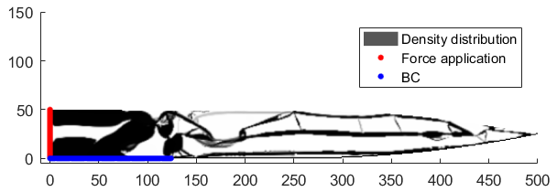
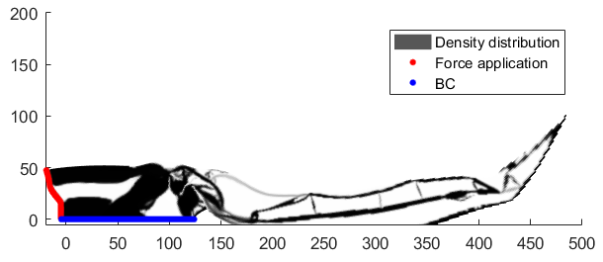


MORPHING WINGLET
$$minimize {\left|\left|LU−U_{obj}\right|\right|}^{2}(ρ,f)$$
Morphing winglet
$$subject to$$
$$V\left(ρ\right)≤V_{0}=0,35$$
Light (volume fraction)
$$σ_{i}(ρ,f,U_{f}(ρ,f))≤σ_{lim}$$
Feasible
$$C\left(ρ,f,U_{f}\left(ρ,f\right)\right)≤C_{max}$$
Continuous chain
$$∑F\left(ρ,f \right)≤F_{min}=−1,5$$
Continuous chain
$$F=\frac{\arctan\left(sf\right)}{\arctan\left(s\right)}ρ_{node}^{k} k=1/p$$
$$E={E_{min}+ρ}^{p}\left(E_{0}−E_{min}\right) E_{min}=E_{0}∗{10}^{−4}$$
Linear FE Analysis

